Slide 1

Strategic Awareness
of Industry Trends:
A Complete Solution using
BeautifulSoup, Nltk, and Tabpy on
Indeed.com Postings
August 14, 2018
Team 12
Himanshu Kulkarni | Kitlyn (Hui-Lun) Kuo | Pranav Lingaraju
Raghuveer Rao Vijjini | Sydney Jiang | Wade Wimer

Slide 2

Job Postings
Trending topics/technologies
Competitor hiring trends
Location and industry based job market
Hiring trends for companies/industry over time (prototype)

Slide 3
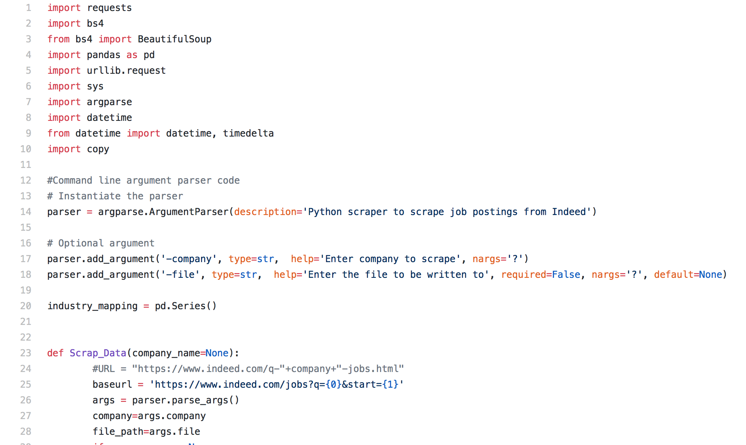
BeautifulSoup
Navigating, Searching, and Modifying parse
Informative variables from Job titles, Regions, Industries, which provide valuable insights

Slide 4
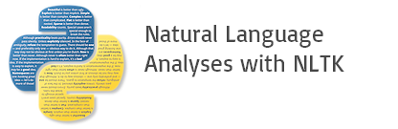
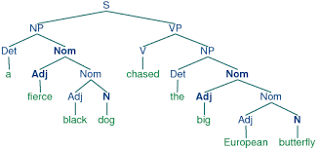
Nltk
Text analytics application
TF-IDF, n-grams

Slide 5

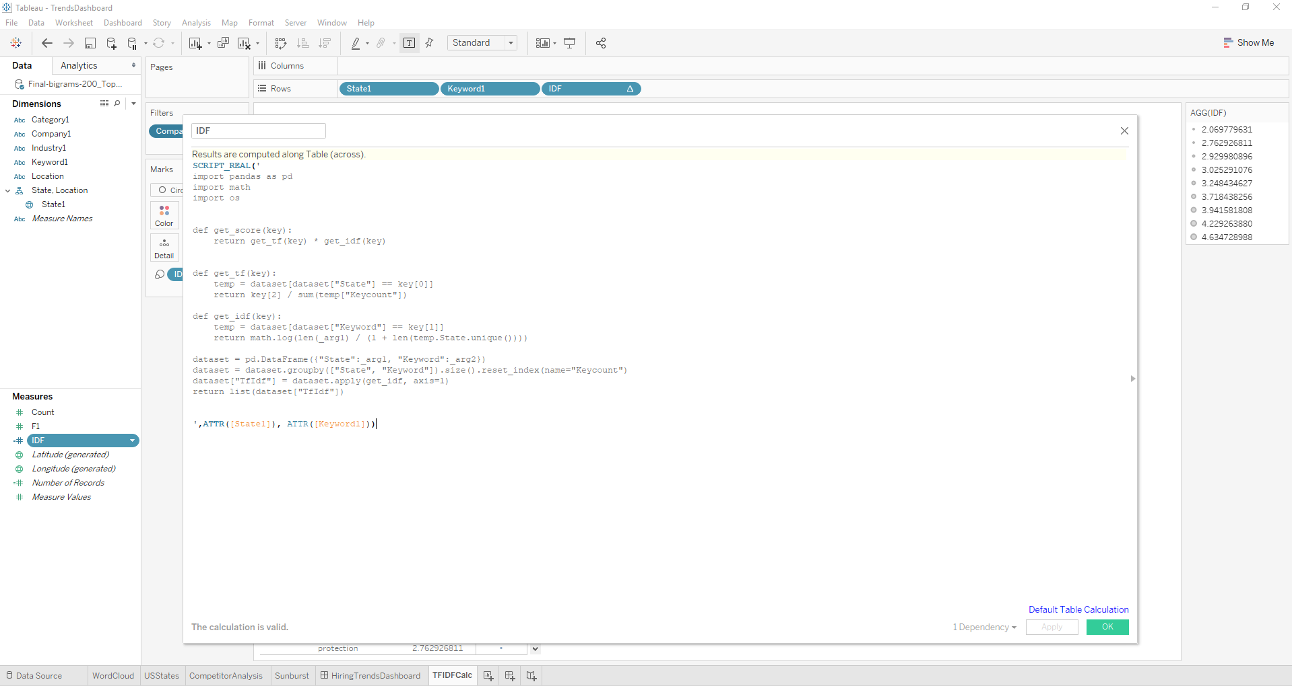
Tabpy Integration of python capabilities in Tableau
Utilize Python’s functionalities to improve Tableau Capabilities
Calculation
Visualization

Slide 6
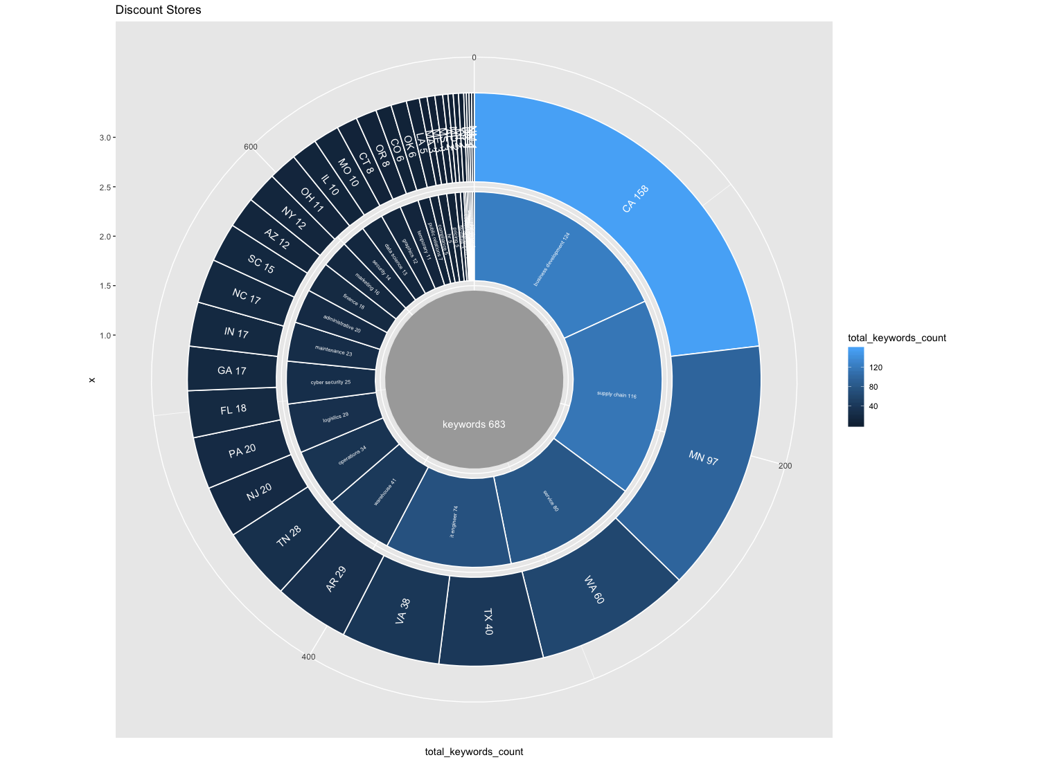
Visualization
Identifying proportions of job categorizations across regions
Discount
Stores

Slide 7
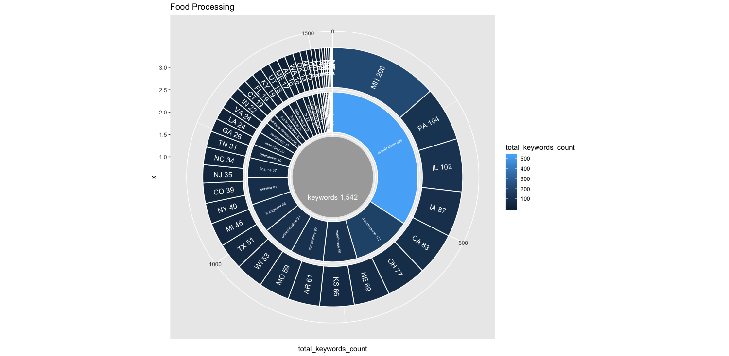
Visualization
Identifying proportions of job categorizations across regions
Food Processing

Slide 8
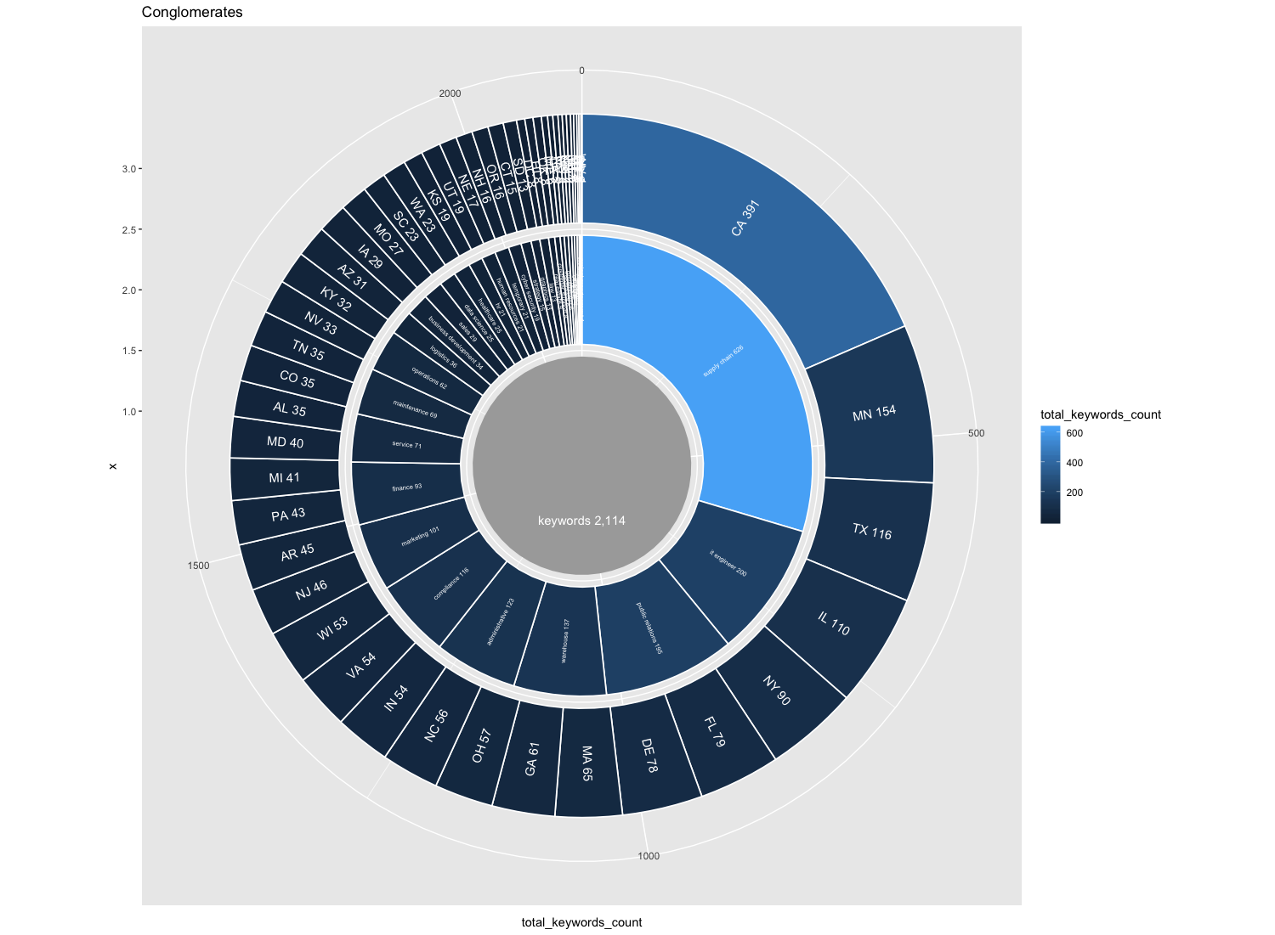
Visualization
Identifying proportions of job categorizations across regions
Conglomerates

Slide 9
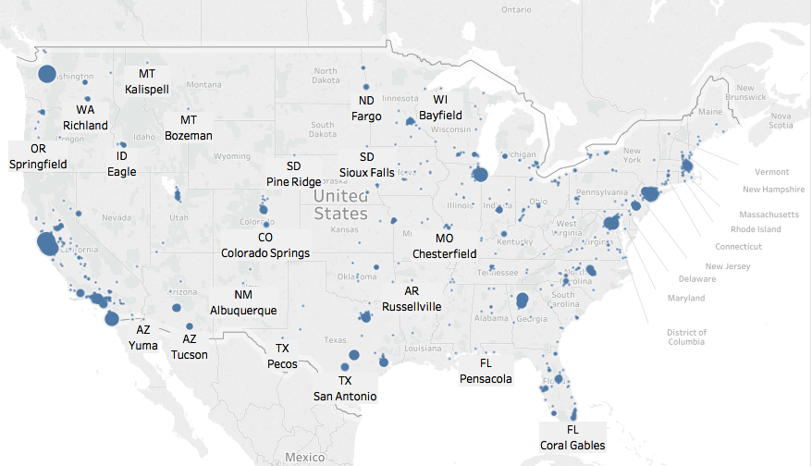
Visualization
Identifying Hiring Trend for Software INDUSTRY in the US

Slide 10
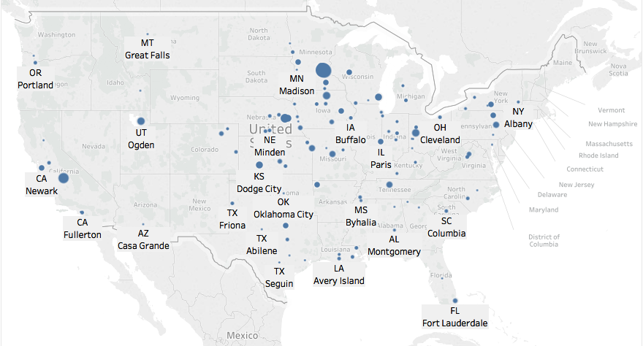
Visualization
Identifying Hiring Trend for Cargill COMPANY in the US

Slide 11
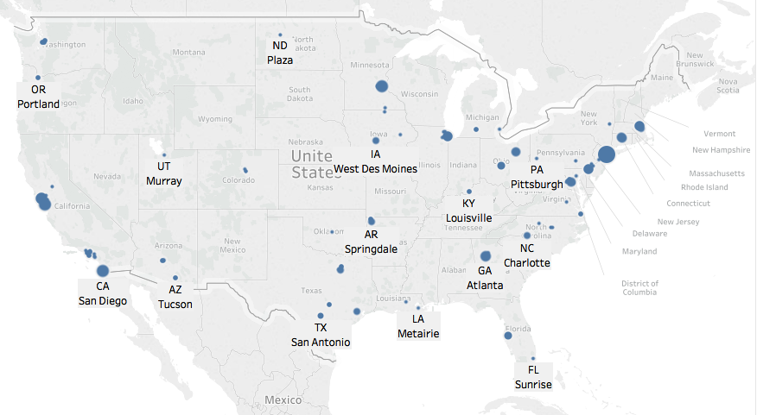
Visualization
Identifying Hiring Trend for Data Science JOB in the US

Slide 12
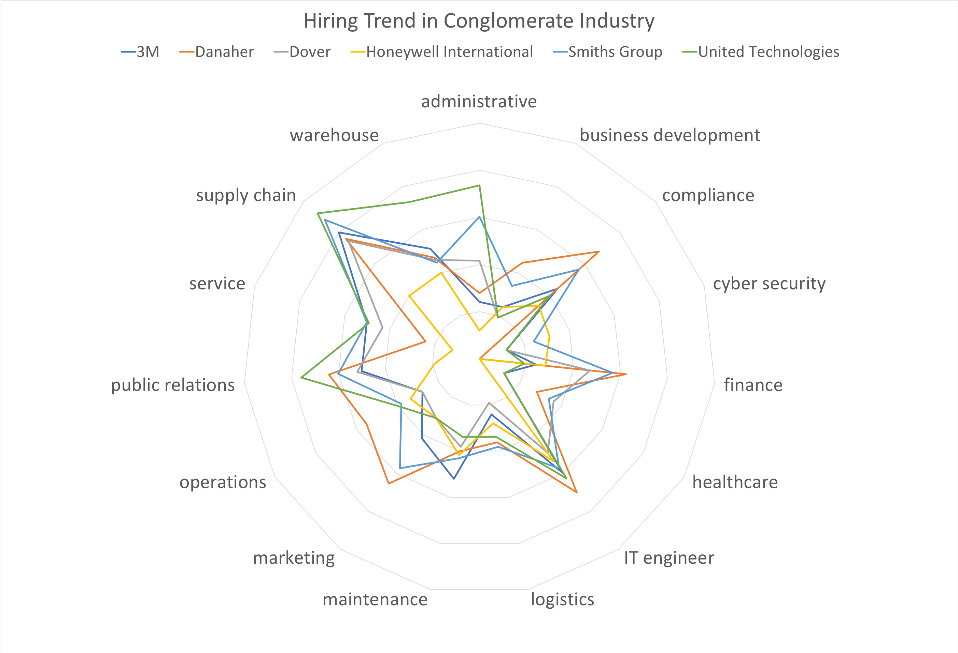
Visualization
Identifying Hiring Trend for Conglomerate Industry Companies

Slide 13
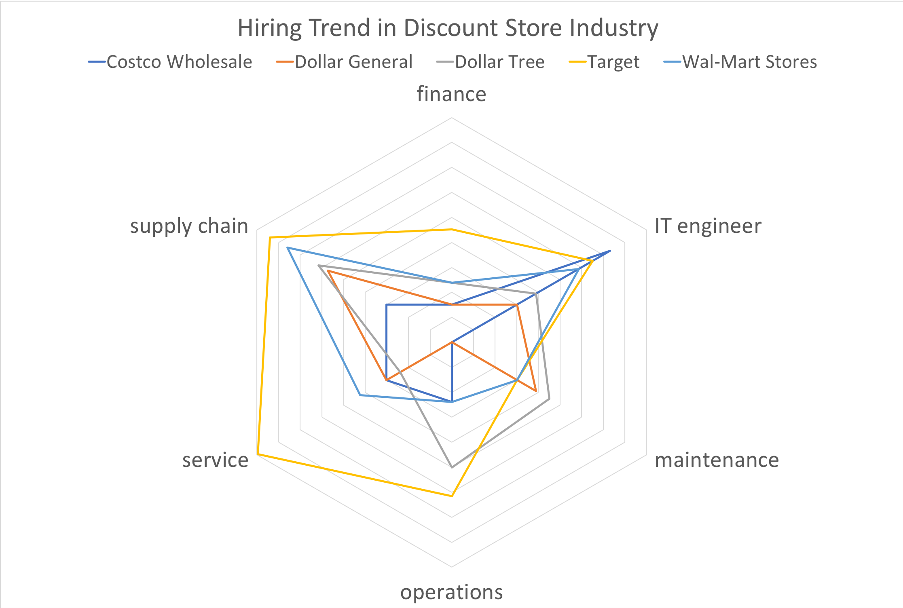
Visualization
Identifying Hiring Trend for Discount Store Industry Companies

Slide 14
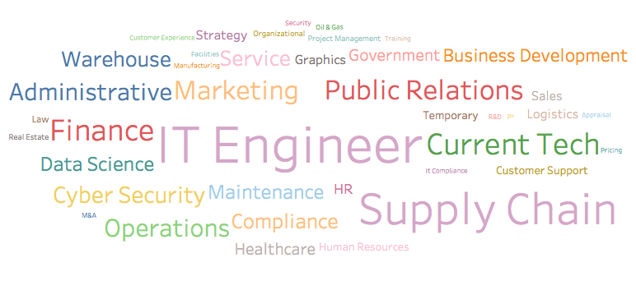
Visualization
Identifying Hiring Trend by Catogeries

Slide 15
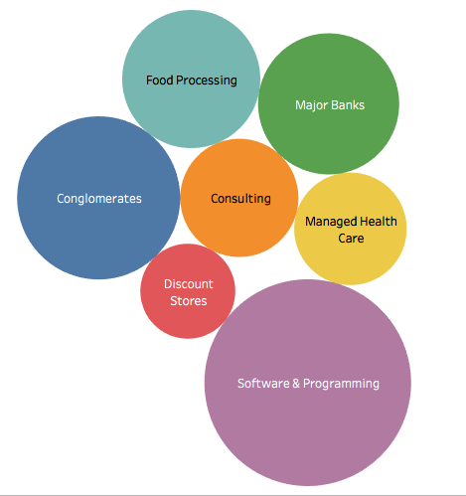
Visualization
Identifying Hiring Trend by Industry

Slide 16
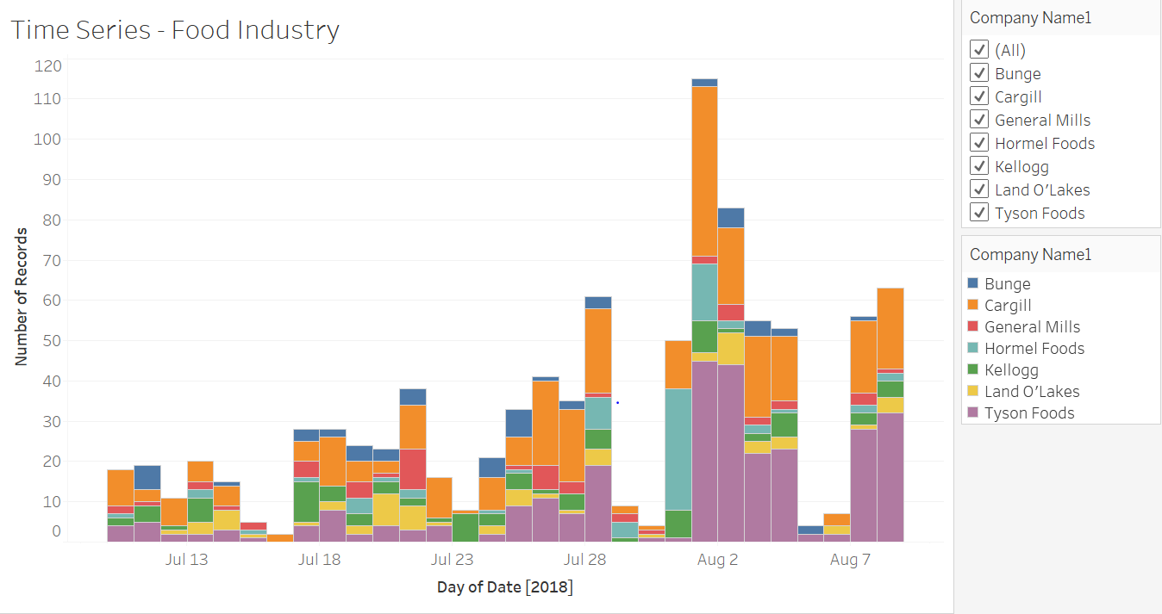
Visualization
Time Series

Slide 17
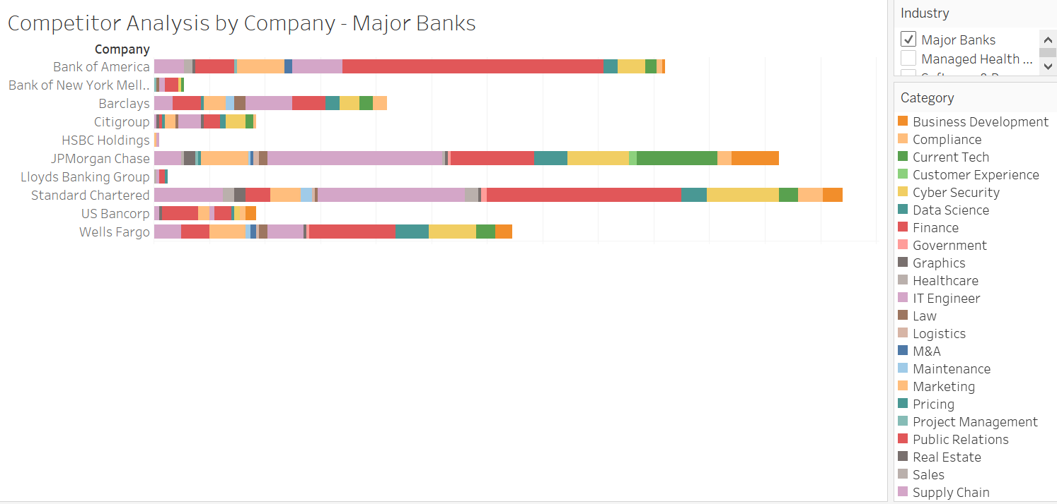
Visualization
Competitor Analysis by Company

Slide 18
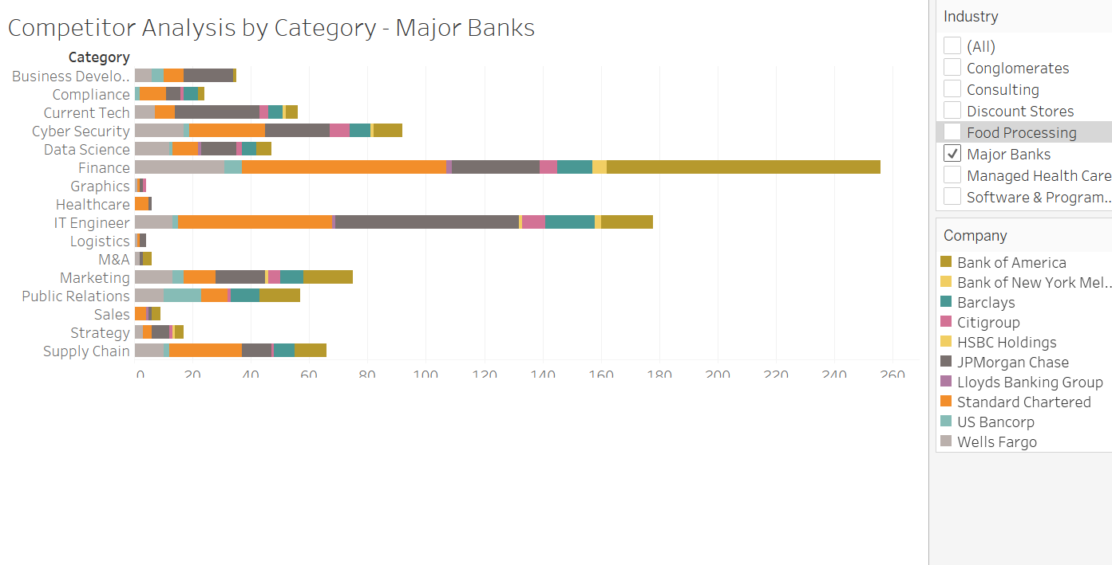
Visualization
Competitor Analysis by Category

